Slide 1

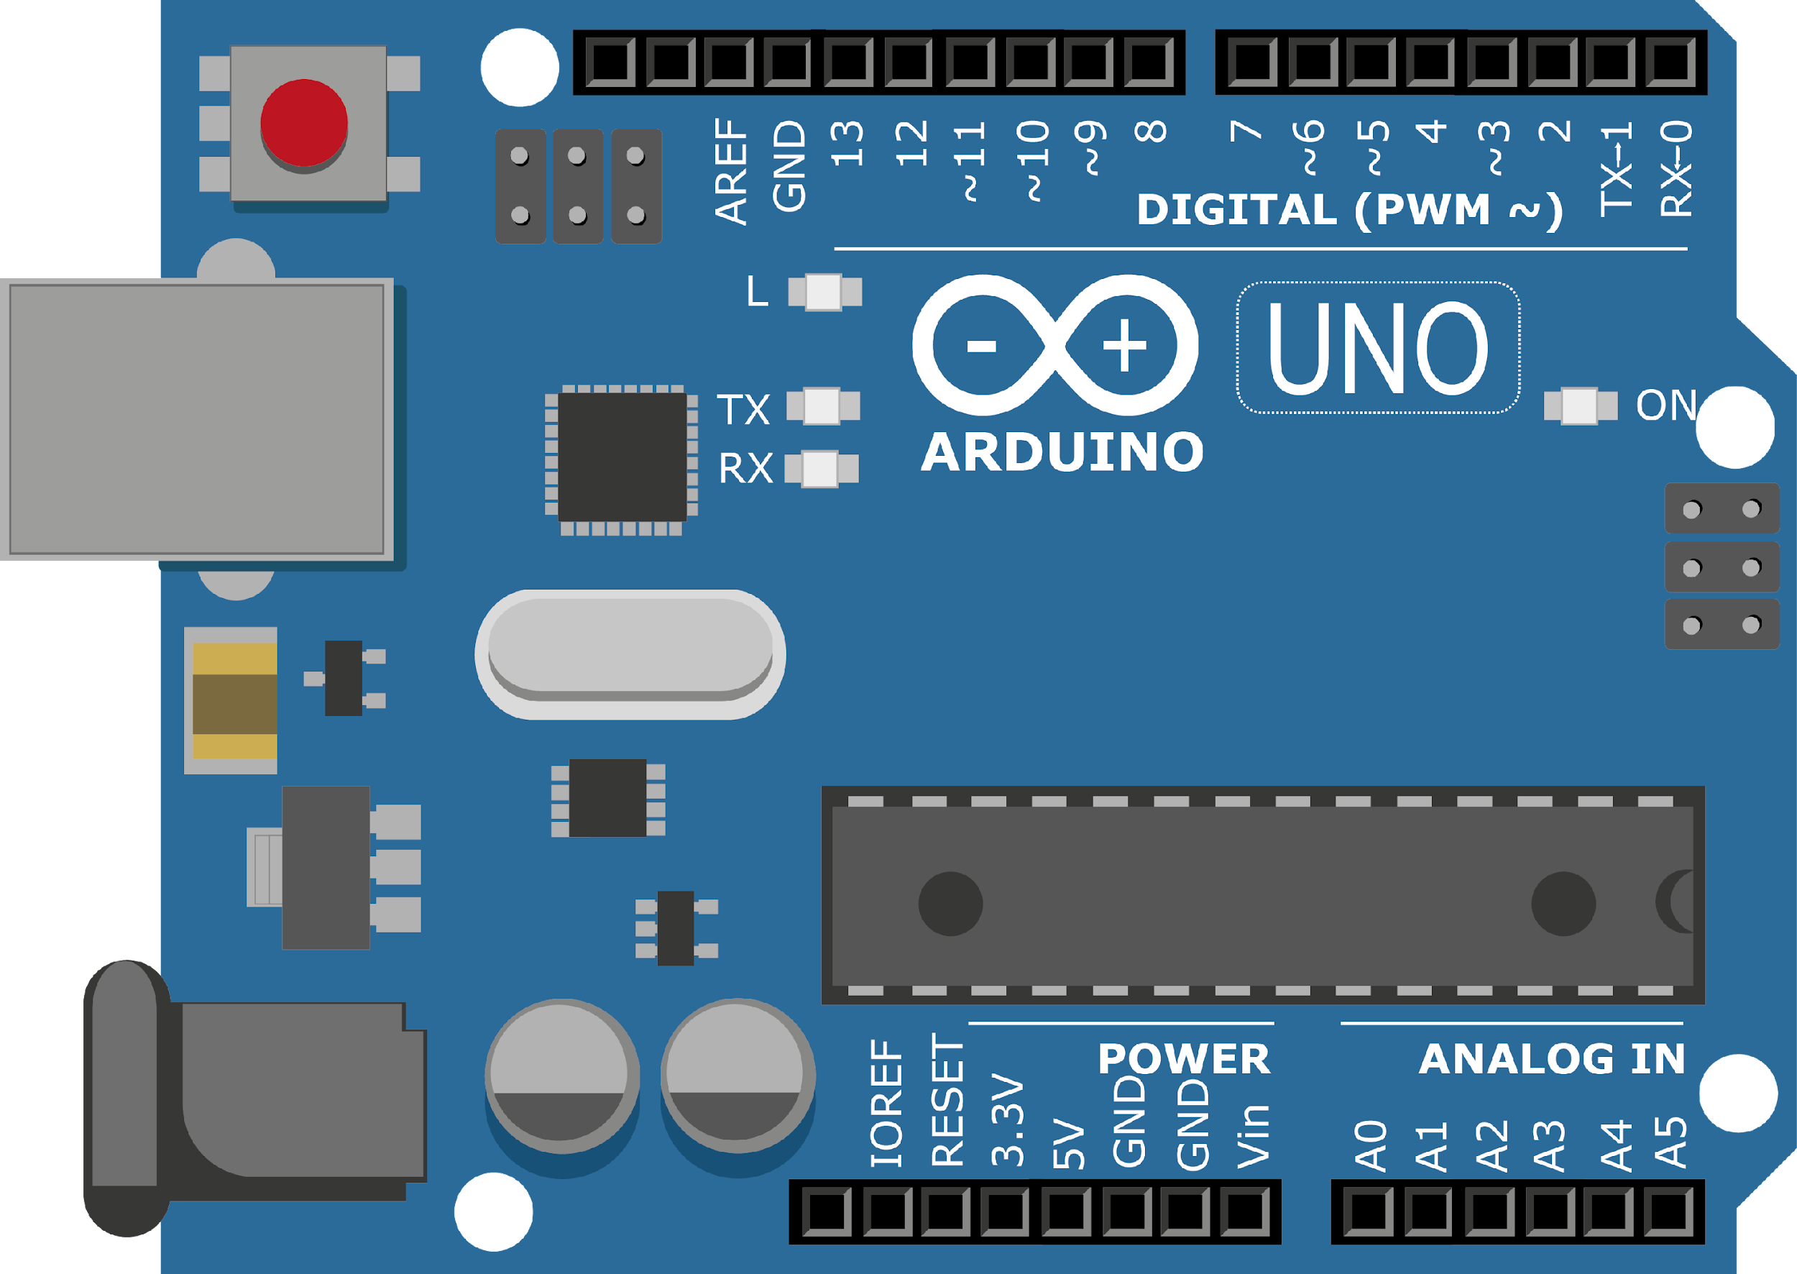
ARDUINO MASTER CLASS
18
Temperature & Humidity detection using DHT11 Sensor

Slide 2
18 AGENDA
02
03
01
Importing Library
DHT11 Sensor
Temperature & Humidity measuring

Slide 3
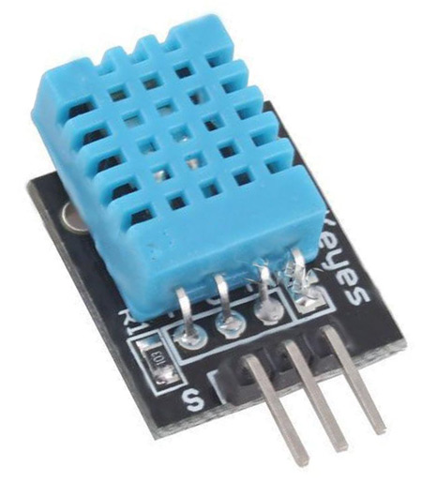
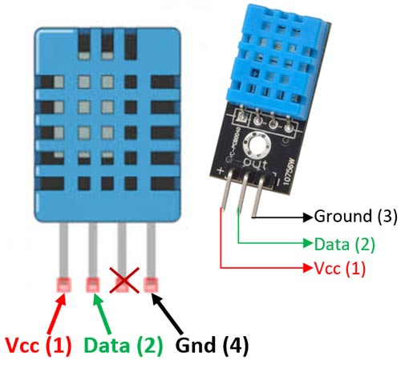
DHT11 Sensor
The DHT11 is a commonly used Temperature and humidity sensor. The sensor comes with a dedicated NTC to measure temperature and an 8-bit microcontroller to output the values of temperature and humidity as serial data. The sensor is also factory calibrated and hence easy to interface with other microcontrollers.

Slide 4
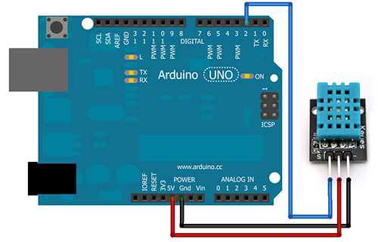
DHT11 Module sensor with Arduino

Slide 5
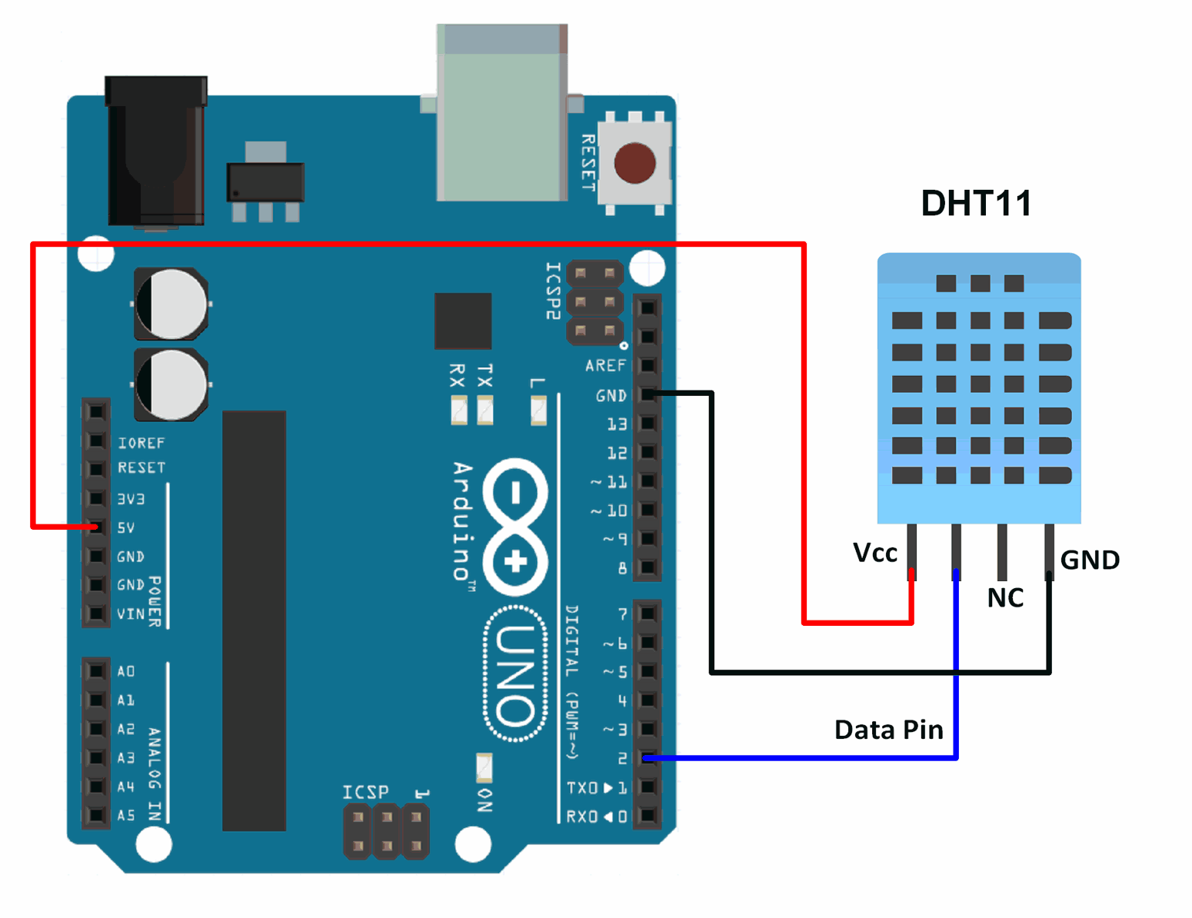
4 Pin DHT11 sensor with Arduino

Slide 6

INTERVIEW QUESTIONS – DAY 18
What is a Clipper & Clamper?
What is Thermistor?
Operational Amplifier?
A circuit that removes a part (positive or negative) of a waveform so that it doesn’t exceed a certain voltage level.
A circuit that adds a DC voltage (positive or negative) to a wave
A thermistor is a resistance thermometer, or a resistor whose resistance is dependent on temperature. The term is a combination of “thermal” and “resistor”. It is made of metallic oxides, pressed into a bead, disk, or cylindrical shape and then encapsulated with an impermeable material such as epoxy or glass.
An operational amplifier is an integrated circuit that can amplify weak electric signals. An operational amplifier has two input pins and one output pin. Its basic role is to amplify and output the voltage difference between the two input pins.

Slide 7

THANKS!

